Slide 1





AI solutions for wellbeing
ING x HackITall
by SICK7

Slide 2
What is one of the most significant problems people face?

Slide 3
Depression
Anxiety
An estimated 4% of the population experiences depression, a number that rises to 5.7% among adults, with women being more commonly affected.
Statistics reveal that over 1/3 of college students are grappling with anxiety disorders, with 36% reporting a diagnosis and 34% experiencing moderate to severe anxiety symptoms.

Slide 4
Social isolation
Strong social connections are vital for our health, yet an estimated 1 in 6 people globally suffer from loneliness. While most common among youth, this overlooked crisis affects all ages—including nearly 12% of older adults—and severely damages our physical health, mental wellbeing, and lifespan.

Slide 5

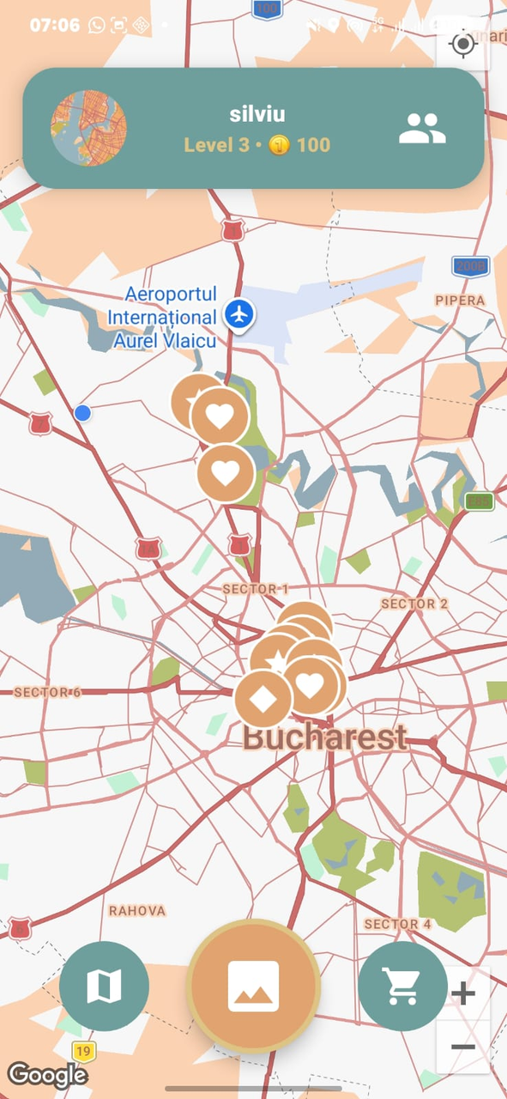

This is where our solution comes in...
Introducing ...
SideQuestr

Slide 6
An interactive, location-based social game where users explore the real world, complete photo-based quests verified and generated by Artificial Intelligence, and earn currency while connecting with friends.
What is
SideQuestr

Slide 7
Who likes SIDE QUESTS???

Slide 8
Why SideQuestr?
SideQuestr uses screen time to cure screen time. In a world of indoor isolation and doomscrolling, we give people a fun, gamified reason to get off the couch, get their steps in, and breathe fresh air. We are proving that technology can be a powerful catalyst for a healthier, more active lifestyle. Bringing fulfilment and belonging to its users.

Slide 9
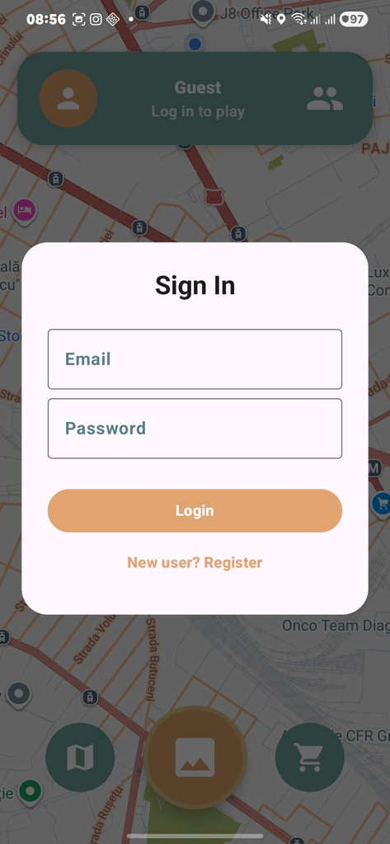
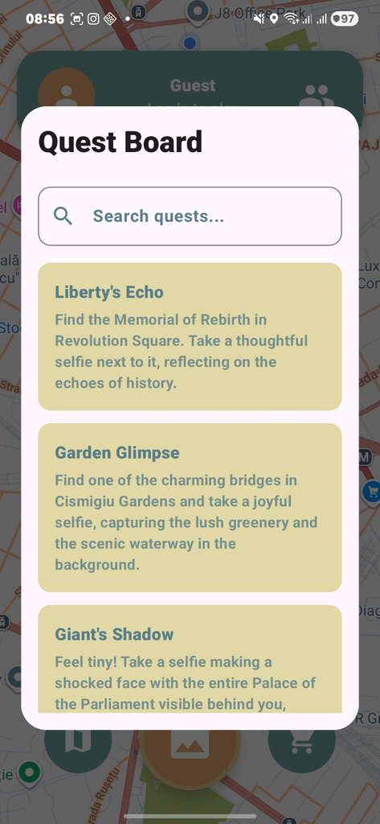
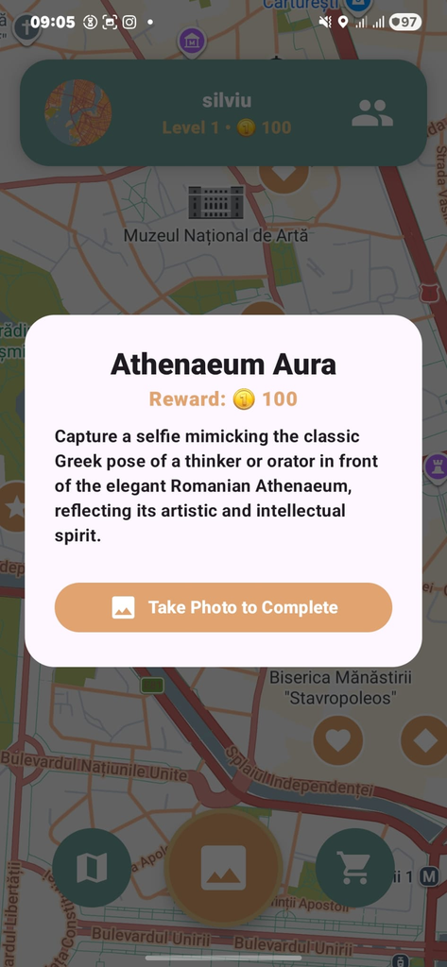
How to use?
Sign in using your e-mail and password.
Check out side quests near you.
Take pictures and collect coins.

Slide 10
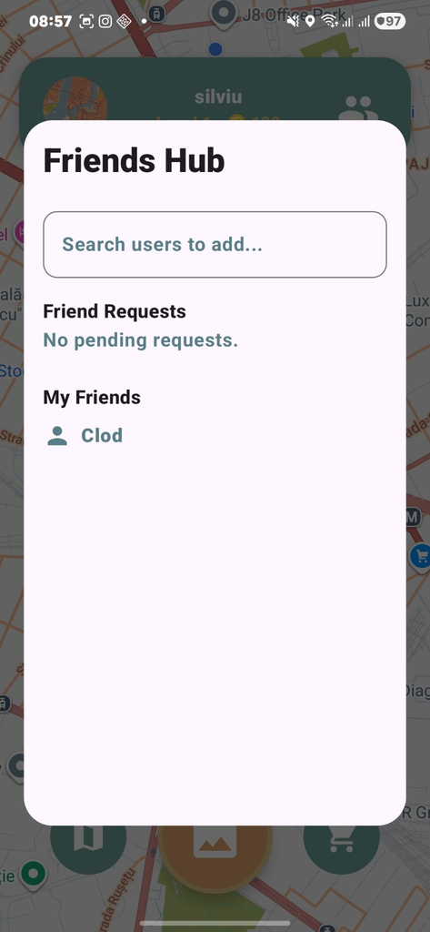

How to use?
Connect with friends.
Use coins to receive gifts.
Have fun!

Slide 11
SideQuestr AI
SideQuestr uses AI to make the game fit you perfectly. It learns from your past choices to create custom quests based on what you like to do. But the AI doesn't just make the map—it’s also the judge. When you take a picture to finish a mission, the AI analyzes the photo to see if it matches the quest description, making the game completely cheat-proof and fair.

Slide 12
Demo time!!!

Slide 13
Thank you for your attention!

